Slide 1
Guard AI
Connor Wilby

Slide 2
Original plan
New Plan
2D
Oxygine
Many supporting systems
Pathfinding
Multi-agent
Behaviour tree command structure
Hierarchical command structure
C++
Unity
3D
Supporting Systems:
Behaviour tree
Pathfinding: Unity Navmesh
Viewcones/detection system
Notes:
The original plan was to create this in 2D using Oxygine, which is a C++ game engine. I was also planning to create multiple supporting systems my project would need.
Unity: The decision to move away from Oxygine was made fairly early on, after I had spent approximately 4 weeks trying, and failing, to set Oxygine up, I realised that spending more time with it would be counter-productive, as even if I could make it work, I would still need to learn its intricacies. Unity was a game engine I knew, and it removed a significant learning curve from this project.
3d: The decision to move to 3D has a number of bonuses, but the primary reason for changing it was for the pathfinding. After a conversation with Chris, he suggested that I remove some of the sub-systems (that were fairly significant) in order to focus on the core of my project, the AI. In addition, it makes my project a lot more portable and useful, since any 3D Unity game that uses the Navmesh could use it.
Behaviour tree: The behaviour tree is the core of this assignment and is therefore what I will focus on before I start anything else.
Pathfinding: Unity navmesh provides a solution to the problem of pathfinding, as well as offering 3D and multi-level levels. This makes my project a lot more versatile, as typically (though not universally) systems like this would be used in 3D games and would be a lot more interesting to potential employers. In addition, Navmesh can use NavMesh Obstacles to effectively achieve multi-agent pathfinding, which is a system that I originally wanted to implement.
Viewcones: I have become very interested in the sight and detection systems used for a stealth AI, more so after watching a GDC talk on how it was handled in Spliter Cell:Blacklist. This is a system I will need to implement.

Slide 3
The New Plan
Unity
3D
Supporting Systems:
Behaviour tree
Pathfinding: Unity Navmesh
Viewcones/detection system
Notes:
Unity: The decision to move away from Oxygine was made fairly early on, after I had spent approximately 4 weeks trying, and failing, to set Oxygine up, I realised that spending more time with it would be counter-productive, as even if I could make it work, I would still need to learn its intricacies. Unity was a game engine I knew, and it removed a significant learning curve from this project.
3d: The decision to move to 3D has a number of bonuses, but the primary reason for changing it was for the pathfinding. After a conversation with Chris, he suggested that I remove some of the sub-systems (that were fairly significant) in order to focus on the core of my project, the AI. In addition, it makes my project a lot more portable and useful, since any 3D Unity game that uses the Navmesh could use it.
Behaviour tree: The behaviour tree is the core of this assignment and is therefore what I will focus on before I start anything else.
Pathfinding: Unity navmesh provides a solution to the problem of pathfinding, as well as offering 3D and multi-level levels. This makes my project a lot more versatile, as typically (though not universally) systems like this would be used in 3D games and would be a lot more useful to potential employers.
Viewcones: I have become very interested in the sight and detection systems used for a stealth AI, more so after watching a GDC talk on how it was handled in Spliter Cell:Blacklist. I will need to add this system in, and unlike the previous subsystems, should be easy to implement.

Slide 4
Currently implemented
Composites:
Selector
Sequence
Decorators:
Succeeder
Failer
Repeater
Notes:
These are the nodes I currently have implemented, these are all structural and can be reused.

Slide 5
Behaviour tree plan
Priority behaviour sections
Player spotted
Guard searching
Secondary behaviours
Patrol
Stationary guard
Idle
Tertiary behaviours
Specific idle
BARK system
Notes:
I have split up the sections my behaviour tree needs to have in order to create an interesting AI. You can see here that I have prioritised them, I will be working on the Player Spotted behaviour first, and then working my way down the list.

Slide 6
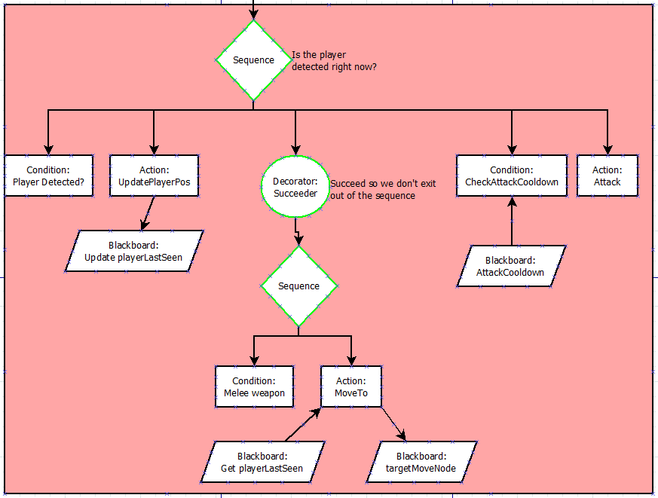
Player Spotted Sub-tree

Slide 7
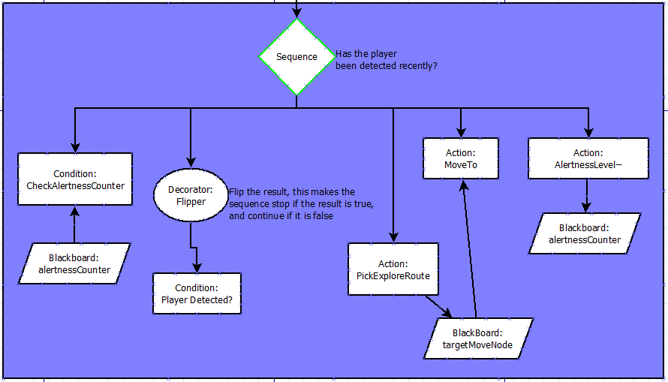
Search Sub-tree

Slide 8
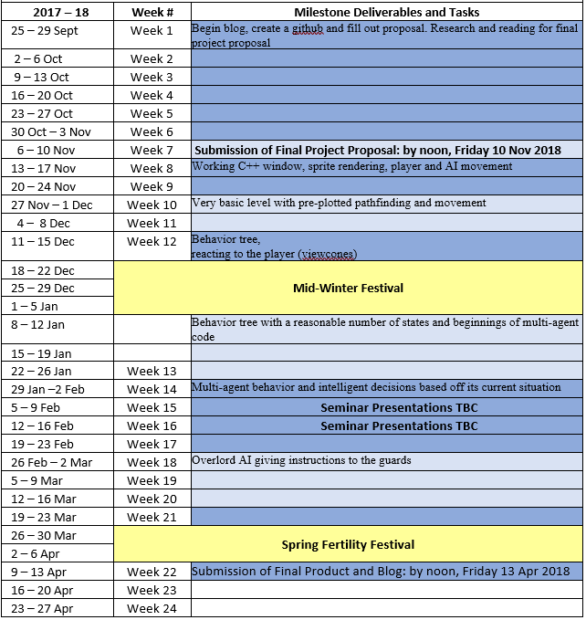
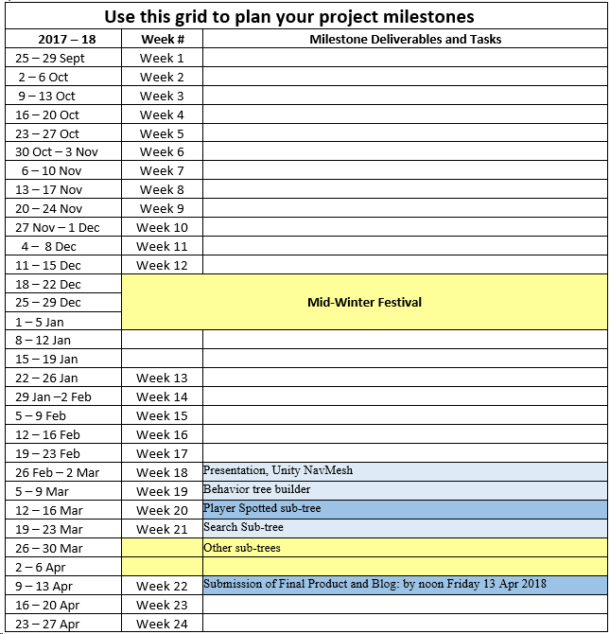
Schedule changes and reasoning
Notes:
Here you can see the changes I have made to my schedule.
The rest of this week (and some of yesterday) will be spent building a basic level and getting a feel for how Unity’s navmesh works.
After that I will work on building my behaviour tree and testing the nodes I already have.
From there I will create the nodes you saw in the previous slides for each of those sub-trees and using the behaviour tree

Slide 9
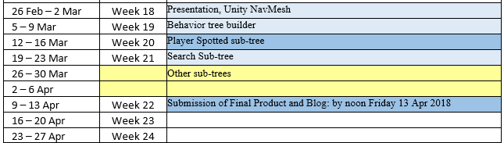
Questions?

